Slide 1
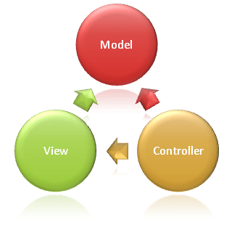
Model - View - Controller
Created by Trygve Reenskaug.
MVC stands for Model-View-Controller, an architectural pattern used to build scalable and maintainable applications.
Purpose of MVC is Separation of concerns between the user interface, business logic, and data.

Slide 2
MVC Architecture Overview
Model:
Represents the data and business logic.
Communicates with the database and processes data based on user actions.
View:
Handles the presentation layer (UI).
Displays data to the user and receives user inputs.
Controller:
Acts as an intermediary between Model and View.
Handles user requests, processes them, and sends responses.

Slide 3
ASP .NET Core MVC
public class HomeController : Controller
{
public IActionResult Index()
{
return View();
// Corresponds to `index.cshtml` in the views folder.
}
}
Overview:
A part of the ASP.NET framework designed to build web applications.
ASP.NET Core MVC is the cross-platform version for modern cloud-based apps.
Key Features:
Routing: Handles URL patterns to map to specific controllers and actions.
Model Binding: Automatically maps form data to model objects.
Dependency Injection: Built-in support for DI to manage service lifetimes.
View Engines: Razor (primary view engine).

Slide 4
Spring MVC
@RestController
public class HomeController
{
@GetMapping("/")
public String home(Model model)
{
model.addAttribute("message", "Welcome to Spring MVC!");
return "home"; // Corresponds to `home.jsp` in the views folder.
}
}
Overview:
Spring Boot is a framework for building microservices and web applications.
It simplifies the configuration of the Spring MVC module.
Key Features:
Annotation-Based Configuration: Annotations like @Controller, @RequestMapping, and @RestController.
Spring Security: Robust authentication and authorization mechanism.
REST API Support: Simplifies the creation of RESTful services.

Slide 5
Conclusion
Both frameworks follow the MVC architecture, but they cater to different ecosystems and development needs.
Developers should choose based on their existing expertise, project requirements, and long-term scalability plans.

